Slide 1
An Introduction to
Reinforcement Learning
By Christopher Torrington

Slide 2
Talk about training dogs

Slide 3
Markov Decision Process

Slide 4
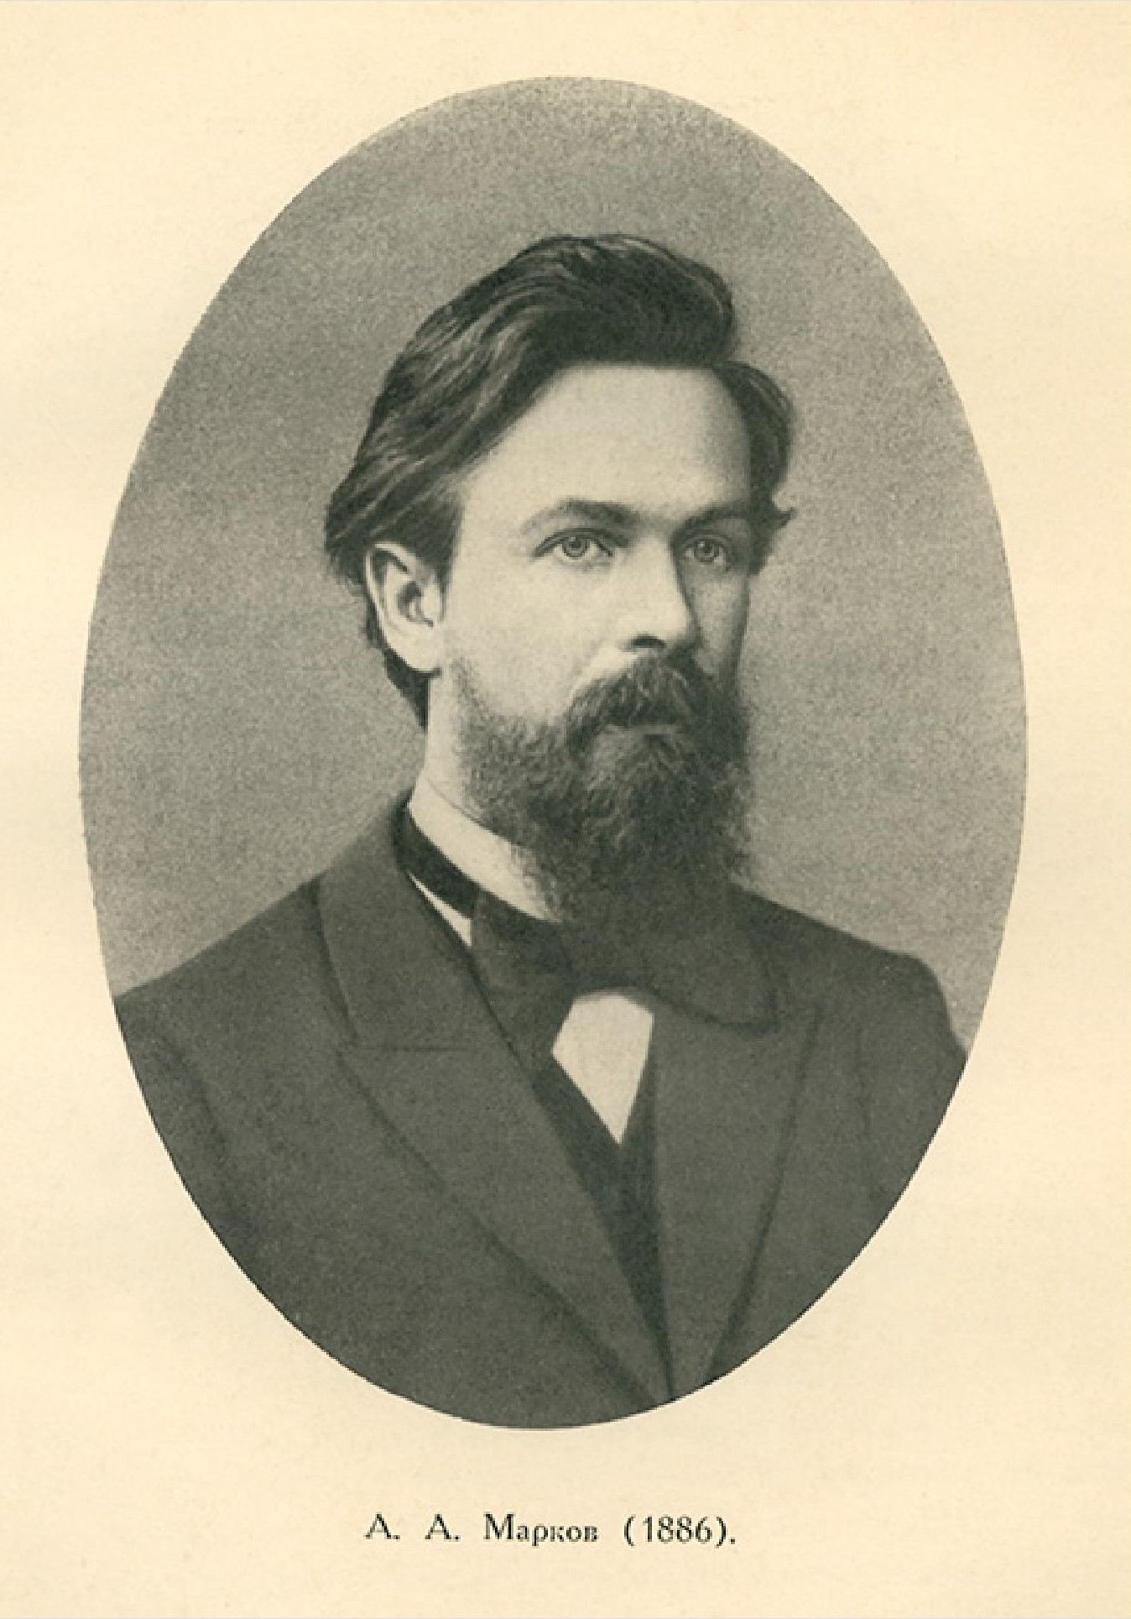
Andrey Markov
Notes:
The name of MDPs comes from the Russian mathematician Andrey Markov as they are an extension of Markov chains.

Slide 5
Main
Space
Reward
+
Academy Room
No reward
Outside
- reward

